Slide 1
Class Diagram, Flowchart, and Documentation
Started on 15 April 2025

Slide 2
Credentials
For EMQX, InfluxDB, Grafana web interface:
username: root
password: root1234
EMQX Broker – [IP address]:1883
EMQX Broker dashboard - [IP address]:18083
InfluxDB dashboard - [IP address]:8086
Grafana dashboard - [IP address]:3000

Slide 3
Class Diagram (Simple)
time
deviceId
session
IoT Box
slot7_state
system_state
flow_monitor
gps_config

Slide 4
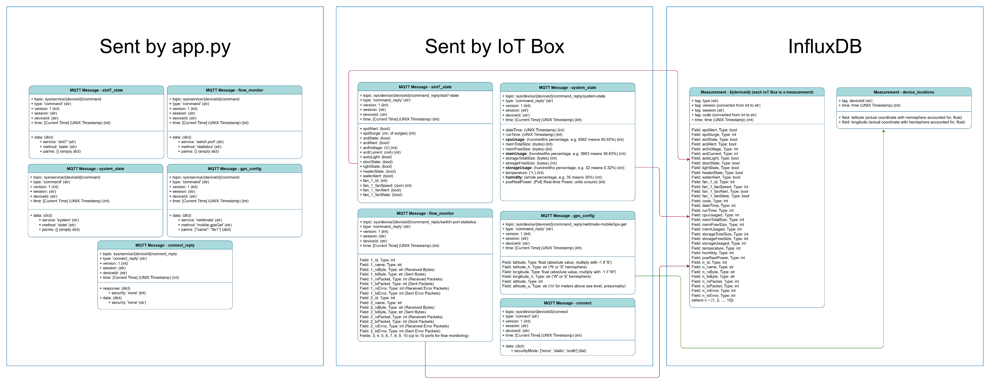
Class Diagram
Currently, the API misspells the bold variables as cpuUsaged, memUsaged, storageUsaged, and humitidy respectively. Pending fix.
For MQTT messages sent by Smart Box, fan and flow monitor variables were formatted for InfluxDB compatibility. See [Example MQTT Messages] slides for the original variables. See flatten_dict() for formatting method.

Slide 5
Connection Handshake
Example connect_reply
{
"type": "connect_reply",
"version": 1,
"session": "125b162f-9c01-4a4b-8000-0ec3256ff69d",
"deviceId": "smartBox_0c7124300bc7fb4e1ceb4acdb7162d74",
"time": 1746494252,
"response": {
"code": 0,
"message": "success"
},
"data": {
"security": "none"
}
}
Example connect
{
"type": "connect",
"version": 1,
"session": "125b162f-9c01-4a4b-8000-0ec3256ff69d",
"deviceId": "smartBox_0c7124300bc7fb4e1ceb4acdb7162d74",
"time": 1746494252,
"data": {
"securityMode": [
"none",
"static",
"ecdh"
]
}
}

Slide 6
Slot7_state
Example command_reply
{
"type": "command_reply",
"version": 1,
"session": "8ae05cc8-dee3-45c9-a72d-4a82bef84765",
"deviceId": "smartBox_56b6440c6e7421e397737893aeb2a36f",
"time": 1744777012,
"response": {
"code": 0,
"message": {
"spdAlert": false,
"spdSurge": 0,
"ardState": true,
"ardAlert": false,
"ardVoltage": 242,
"ardCurrent": 160,
"autoLight": false,
"doorState": true,
"lightState": true,
"heaterState": false,
"waterAlert": false,
"fan": [
{
"id": 1,
"fanSpeed": 30,
"fanAlert": false,
"fanState": false
}
]
}
}
}
Command
{
“type": "command",
"version": 1,
"session": [session],
"deviceId": [deviceId],
"time": [time],
"data": {
"service": "slot7",
"method": "state",
"parms": {}
}
}

Slide 7
Flow_monitor
Example command_reply
{
"type": "command_reply",
"version": 1,
"session": "ec21db29-1e96-4ef7-ac7c-b59c75830cb5",
"deviceId": "smartBox_dcbbfa35c8e5fcd179f84118a2d00254",
"time": 1744777012,
"response": [
{
"id": 1,
"name": "port1",
"rxByte": "363829",
"txByte": "563446",
"rxPacket": 1222,
"txPacket": 1523,
"rxError": 0,
"txError": 0
},
{
"id": 2,
"name": "port2",
"rxByte": "6603229",
"txByte": "22849802",
"rxPacket": 48755,
"txPacket": 36213,
"rxError": 0,
"txError": 0
},
{
"id": 3,
"name": "port3",
"rxByte": "0",
"txByte": "0",
"rxPacket": 0,
"txPacket": 0,
"rxError": 0,
"txError": 0
},
{
"id": 4,
"name": "port4",
"rxByte": "0",
"txByte": "0",
"rxPacket": 0,
"txPacket": 0,
"rxError": 0,
"txError": 0
},
{
"id": 5,
"name": "port5",
"rxByte": "0",
"txByte": "0",
"rxPacket": 0,
"txPacket": 0,
"rxError": 0,
"txError": 0
},
{
"id": 6,
"name": "port6",
"rxByte": "0",
"txByte": "0",
"rxPacket": 0,
"txPacket": 0,
"rxError": 0,
"txError": 0
},
{
"id": 7,
"name": "port7",
"rxByte": "0",
"txByte": "0",
"rxPacket": 0,
"txPacket": 0,
"rxError": 0,
"txError": 0
},
{
"id": 8,
"name": "port8",
"rxByte": "0",
"txByte": "0",
"rxPacket": 0,
"txPacket": 0,
"rxError": 0,
"txError": 0
},
{
"id": 9,
"name": "port9",
"rxByte": "0",
"txByte": "0",
"rxPacket": 0,
"txPacket": 0,
"rxError": 0,
"txError": 0
},
{
"id": 10,
"name": "port10",
"rxByte": "0",
"txByte": "0",
"rxPacket": 0,
"txPacket": 0,
"rxError": 0,
"txError": 0
}
]
}
Command
{
“type": "command",
"version": 1,
"session": [session],
"deviceId": [deviceId],
"time": [time],
"data": {
"service": "switch.port",
"method": "statistics",
"parms": {
}
}

Slide 8
System_state
Example command_reply
{
"type": "command_reply",
"version": 1,
"session": "ec21db29-1e96-4ef7-ac7c-b59c75830cb5",
"deviceId": "smartBox_dcbbfa35c8e5fcd179f84118a2d00254",
"time": 1744777012,
"response": {
"code": 0,
"message": {
"dateTime": 1744805812,
"runTime": 7925,
"cpuUsaged": 9797,
"memTotalSize": 246452,
"memFreeSize": 173616,
"memUsaged": 2955,
"storageTotalSize": 1997240,
"storageFreeSize": 1990896,
"storageUsaged": 31,
"temperature": 29,
"humitidy": 51,
"poeRealPower": 0
}
}
}
Command
{
“type": "command",
"version": 1,
"session": [session],
"deviceId": [deviceId],
"time": [time],
"data": {
"service": "system",
"method": "state",
"parms": {}
}
}

Slide 9
Gps_config
Command
Example command_reply
{
“type": "command",
"version": 1,
"session": [session],
"deviceId": [deviceId],
"time": [time],
"data": {
"service": "netdmate",
"method": "mobile.gpsGet",
"parms": {"name": "lte1"}
}
}
{
"type": "command_reply",
"version": 1,
"session": "ec21db29-1e96-4ef7-ac7c-b59c75830cb5",
"deviceId": "smartBox_dcbbfa35c8e5fcd179f84118a2d00254",
"time": 1744777012,
"response": {
"latitude": 1.4531,
"latitude_h": "N",
"longitude": 103.792291,
"longitude_h": "E",
"altitude": 62.6,
"altitude_u": "M"
}
}

Slide 10
Start up NMS 2.0
Open Docker Desktop (Docker engine must be running)
Open Terminal on Docker Desktop or cmd
cd to nms2 folder directory
Enter “docker compose up -d --build”
Open Grafana in web browser using [IP address]:3000 (any device connected to NMS 2.0 computer via TCP can open Grafana page)
See 1 Demo Video (Startup)

Slide 11
NMS 2.0 Diagnostics
Docker Desktop for container/service status
Terminal or cmd > Enter “docker attach python_app” to view Python app.py terminal output containing logs
Ensure Smart Boxes have NMS 2.0 computer’s IP address set as an MqttBroker address
See 2 Demo Video (Diagnostics) and 2.5 Demo Video (Smart Box)

Slide 12
Navigate NMS 2.0
Filter devices using deviceId dropdown list
Navigate different dashboards using Navigate to Page button
See 3 Demo Video (Navigation)

Slide 13
Shutdown NMS 2.0
Depending on use case, use one of the following:
Stop only python_app by selecting python terminal, then enter Ctrl+C (KeyboardInterrupt is coded to stop threads safely).
Stop NMS 2.0 by entering “docker compose stop” in regular terminal/cmd, then “docker compose start” to restart.
Delete NMS 2.0 container (not local files) by entering “docker compose down” in regular terminal/cmd.
You can now make changes to nms2 files, then “docker compose up” to rebuild the updated app and see the changes.
See 4 Demo Video (Shutdown)

Slide 14
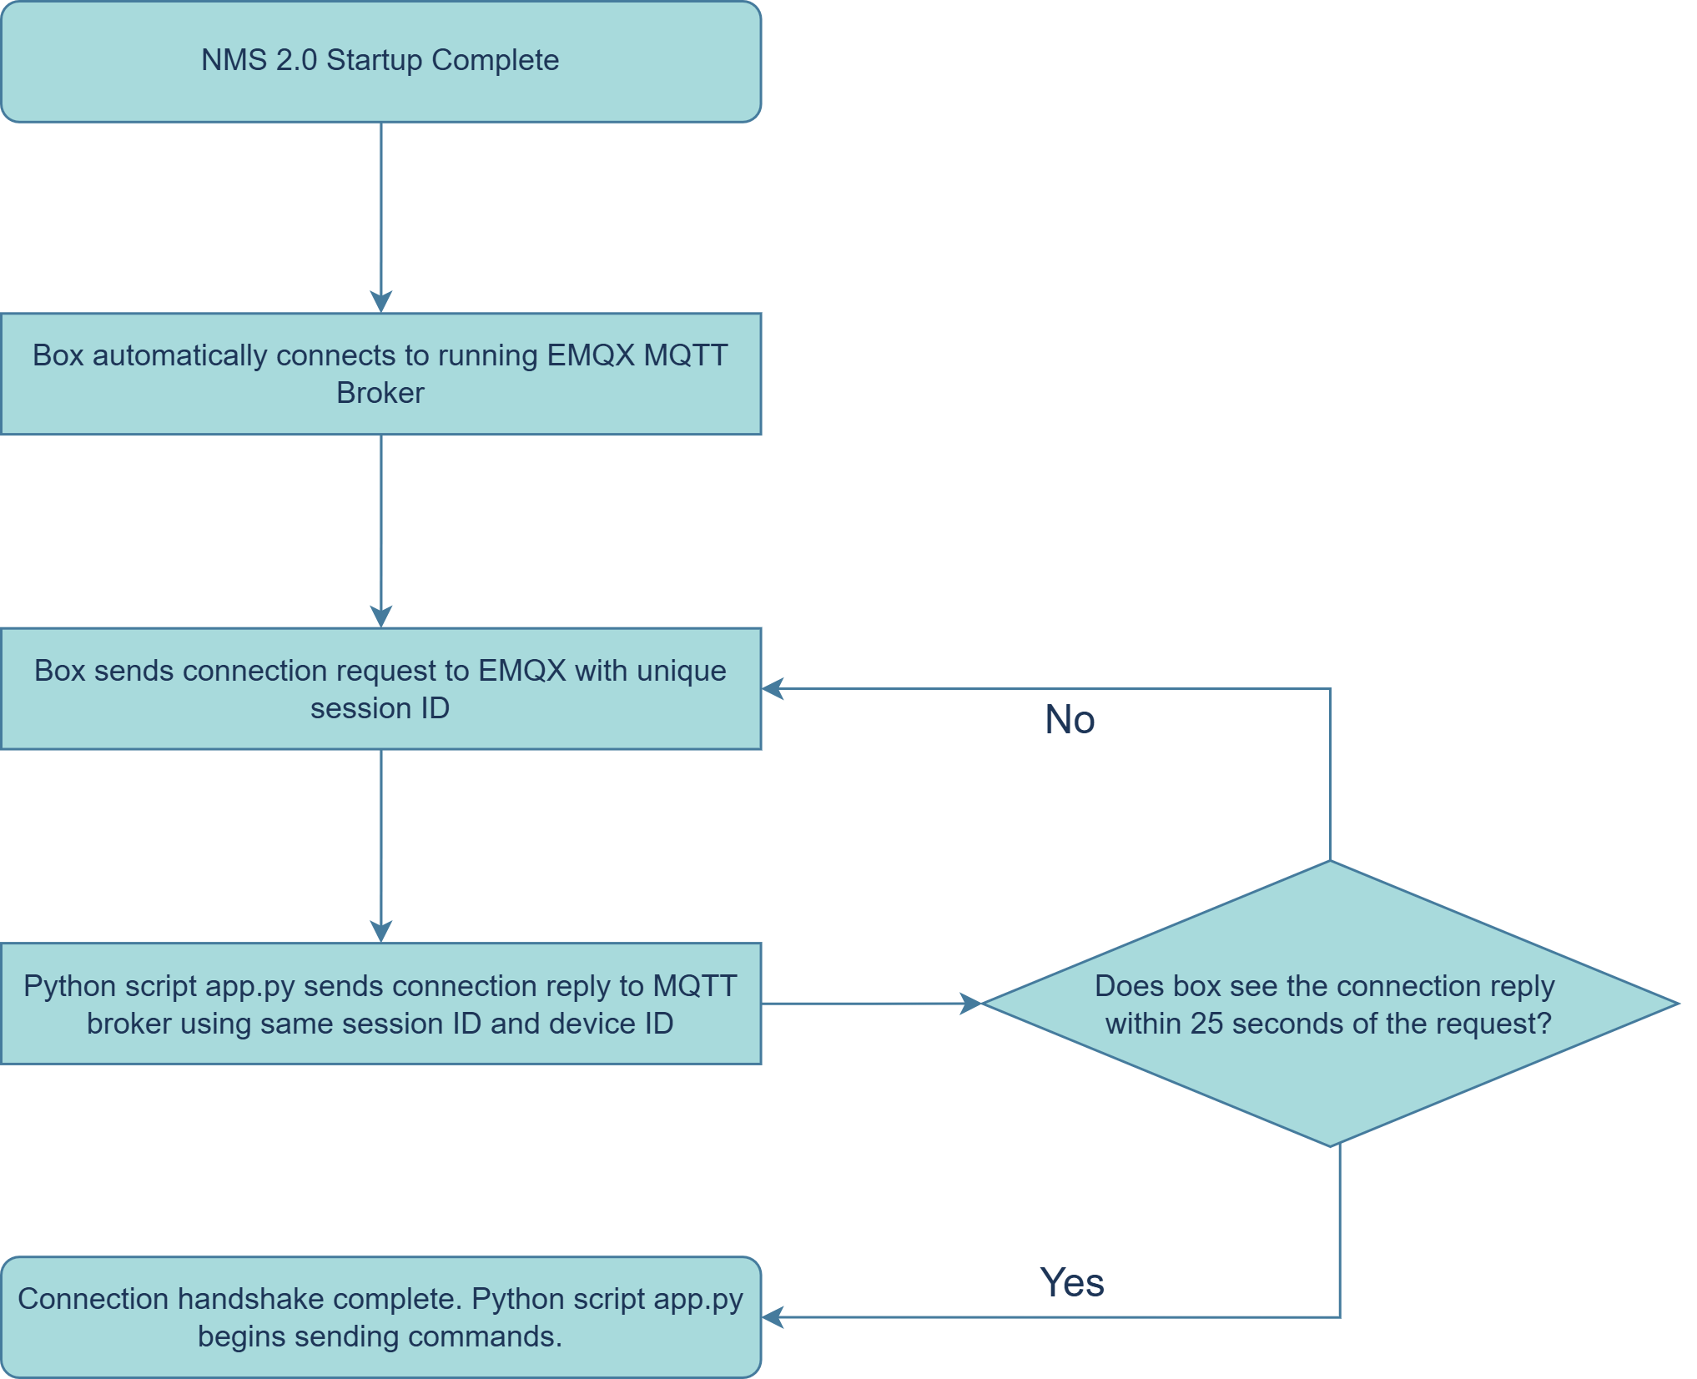
Connection Handshake Flowchart
See Slide 10

